Slide 1

50.039 Theory and Practice of Deep Learning W3-S1 Introduction to Deep Learning using the PyTorch framework
Matthieu De Mari

Slide 3
Hyperparameters tuning and searching
Definition (hyperparameters tuning and searching):
Earlier, we have identified that several parameters in our neural networks had to be manually decided by the user and called those hyperparameters.
Unfortunately, the NFL theorem tells us there is often no closed-form formula to tell you what is the best value to use for those hyperparameters.
Typical hyperparameters include:
Number of layers and their sizes,
Initializers to use for parameters,
Activation functions to use,
Learning rate, momentum and other parameters related to optimizers,
Etc.
No choice: try different values and possibilities.

Slide 4
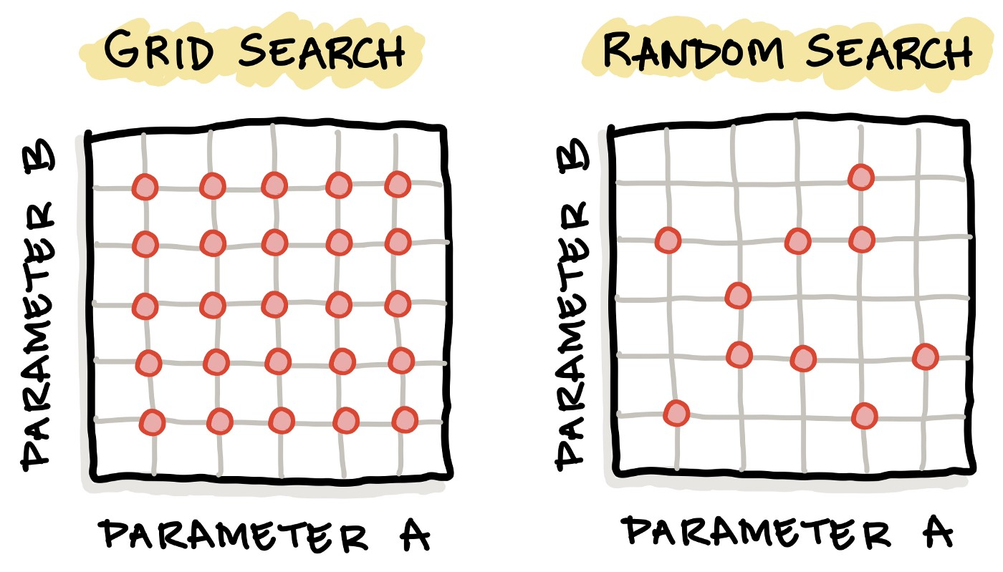
Hyperparameters tuning and searching
Definition (hyperparameter grid searching):
Grid search is the simplest algorithm for hyperparameter tuning.
Basically, we divide the domain of possible values for each of the hyperparameters into a discrete grid. Then, we will try every combination of values of this grid, calculating some performance metrics.

Slide 5
Hyperparameters tuning and searching
Definition (hyperparameter random searching):
Random search is the another algorithm for hyperparameter tuning.
Random search defines a search space as a bounded domain of hyperparameter values and randomly sample points in that domain. After trying enough values, keep the best hyperparameters configuration.

Slide 6
Hyperparameters tuning and searching
In general ([HypSearch]),
grid search is often better on small spaces,
whereas random search is better on large domains, but has no guarantee of returning a good configuration.
More advanced techniques than these two exist, such as Bayesian Optimization and Evolutionary Optimization.

Slide 7
About this week (Week 3)
XXX

Slide 8

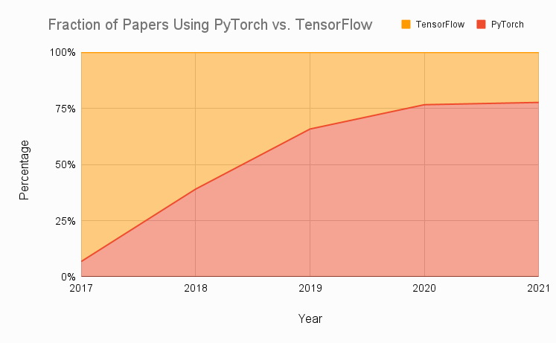
Technical pre-requisites
Framework of choice will be PyTorch! (not Tensorflow, not Keras, not MXNet, etc.)
Increasing popularity and preferred to Google’s Tensorflow these days for many reasons.
Learn more, if curious: https://www.assemblyai.com/blog/pytorch-vs-tensorflow-in-2022/

Slide 9
On the benefits of using PyTorch
There are several benefits to using PyTorch over NumPy for implementing neural networks:
More intuitive interface for working with tensors and neural networks.
NumPy is primarily a numerical computing library.
PyTorch is specifically designed with deep learning, and provides a more natural and convenient interface.
Large active community of users.
Many tutorials, detailed documentations and implementations on Github.
Stack overflow equivalent.
PyTorch has better support for GPU acceleration than NumPy.
If a GPU is available, significantly speed up the training of our neural network by performing the computations on the GPU using PyTorch.
Especially useful for training large and complex models.
High-level abstractions for building and training neural networks.
Easier to write and debug code,
Improve the performance of our model by allowing PyTorch to apply optimization techniques
More specifically, automatic differentiation!

Slide 10
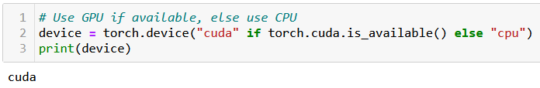
At this point, you should have installed PyTorch, and if possible, CUDA
You can check for CUDA/GPU capabilities, using the line below. If the CUDA has not been properly installed or the GPU is not compatible, you will be using a CPU instead.
We strongly advise to take a moment to make sure your machine is CUDA enabled, assuming your GPU is compatible. When CUDA is properly installed on a compatible GPU, the line below should display cuda, otherwise it will print cpu.

Slide 11
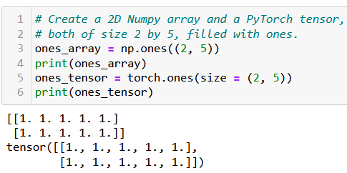
The Tensor object
Definition (Tensor):
The tensor is PyTorch's basic building block and is similar to NumPy arrays.
This is why most of the concepts and methods will look similar
However, these come with additional features, which will be useful later on when building Neural Networks with these tensors.

Slide 12
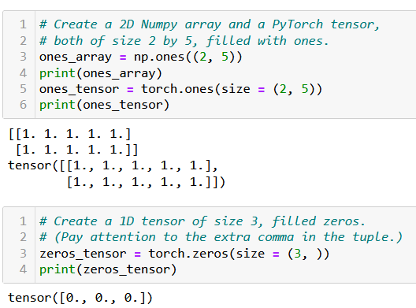
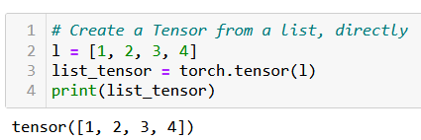
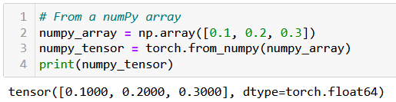
Creating a Tensor
Tensors can be simply created as in NumPy, by using zeros() or ones() functions, specifying dimensions of the expected Tensor, with tuples.
They can also be created from a list (of lists) of values, by passing it to the tensor() function.
Or from a Numpy array, using the from_numpy() method.

Slide 13
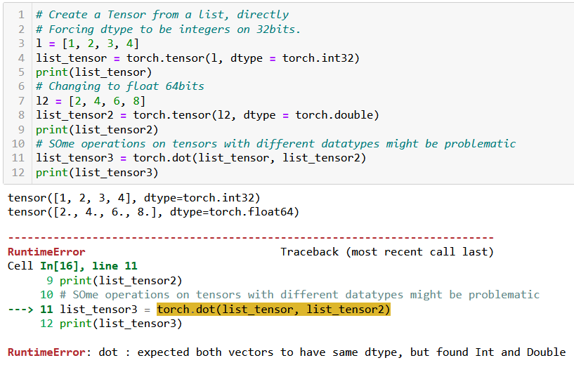
Tensor datatypes (dtypes)
Definition (dtypes):
PyTorch tensors have an attribute called dtype, which tracks the datatype of values stored in the tensor.
See link below for more details on the possible dtypes. https://www.tensorflow.org/api_docs/python/tf/dtypes
In general, operations between tensors require compatible, and sometimes identical dtypes.
Here, the dot product failed because one tensor was int, and the other was float/double.

Slide 14
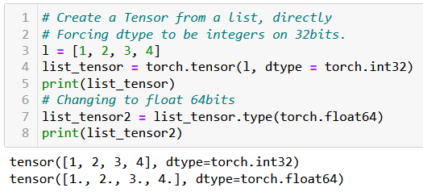
Tensor datatypes (dtypes)
Definition (dtypes):
PyTorch tensors have an attribute called dtype, which tracks the datatype of values stored in the tensor.
See link below for more details on the possible dtypes. https://www.tensorflow.org/api_docs/python/tf/dtypes
In general, operations between tensors require compatible, and sometimes identical dtypes.
You can change the dtype of a tensor
- by either specifying it explicitly during its creation;
- or by using the type() method on the tensor, casting a new dtype.

Slide 15
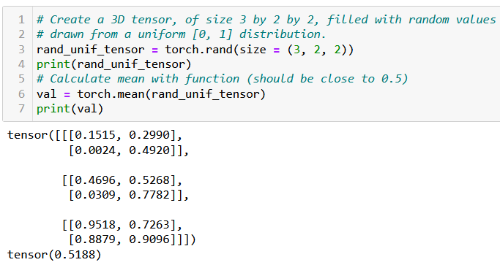
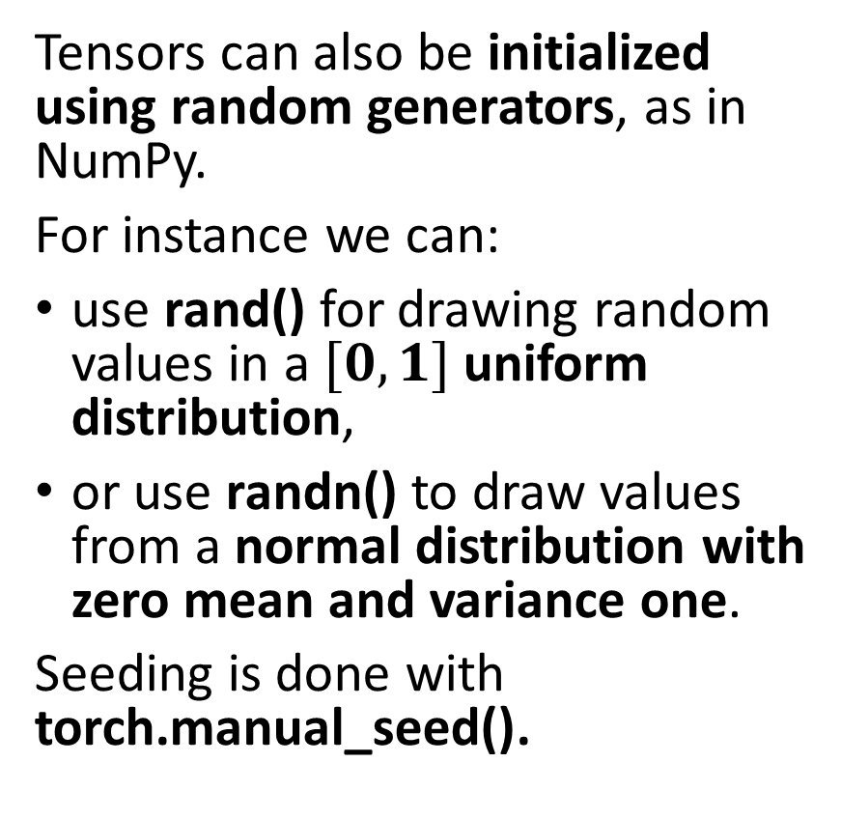
Tensor random initializers
Tensors can also be initialized using random generators, as in NumPy.
For instance we can:
use rand() for drawing random values in a $[0, 1]$uniform distribution,
or use randn() to draw values from a normal distribution with zero mean and variance one.
Seeding is done with torch.manual_seed().
Functions and methods exist for calculating mean values of a tensor, its standard deviation/variance, etc.

Slide 16
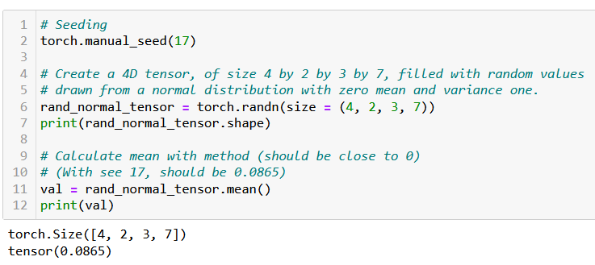
Tensor random initializers
Tensors can also be initialized using random generators, as in NumPy.
For instance we can:
use rand() for drawing random values in a $[0, 1]$uniform distribution,
or use randn() to draw values from a normal distribution with zero mean and variance one.
Seeding is done with torch.manual_seed().
Functions and methods exist for calculating mean values of a tensor, its standard deviation/variance, etc.

Slide 17

Additional attributes of Tensors
Tensors come with many attributes and methods, e.g. asking the shape of a tensor, like in NumPy, is done using the shape attribute.

Slide 18
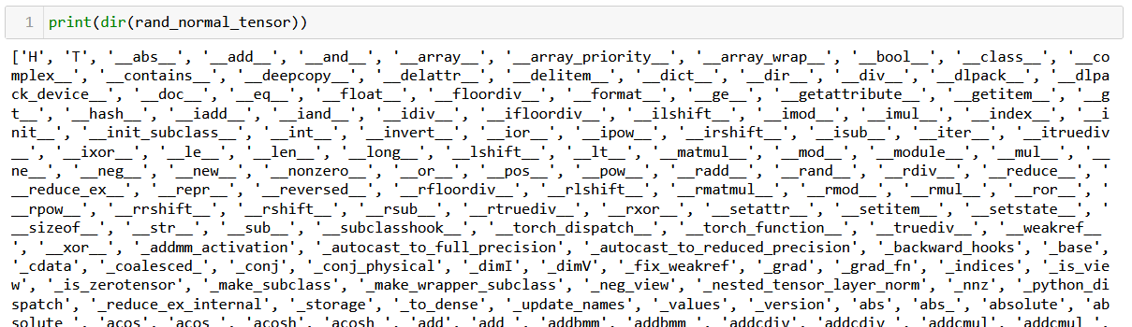
Additional attributes of Tensors
Tensors come with many attributes and methods, e.g. asking the shape of a tensor, like in NumPy, is done using the shape attribute.
Too many of them for me to cover, so RTFM!

Slide 19
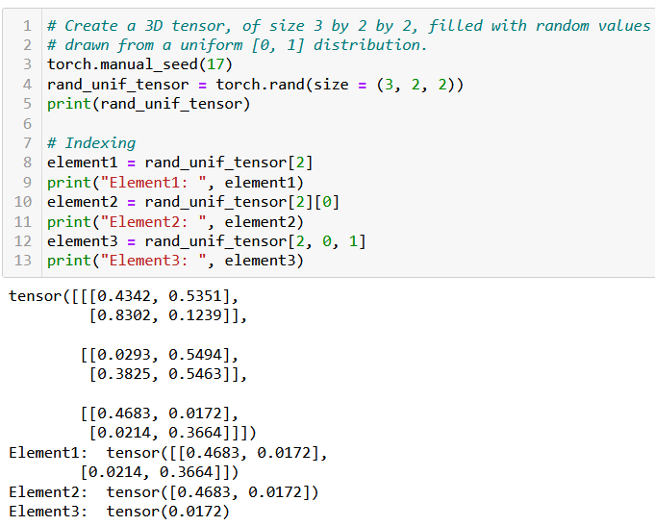
Basic operations on Tensors
All the typical element-wise operations work on tensors. For instance, we can:
access elements using the square bracket notation, multiple square bracket notations and multiple indexes in a single square bracket;
slice a tensor using the square bracket notation and colon symbol;
update elements of a tensor using the square bracket notation;
browse through elements of a tensor using a for loop.

Slide 20
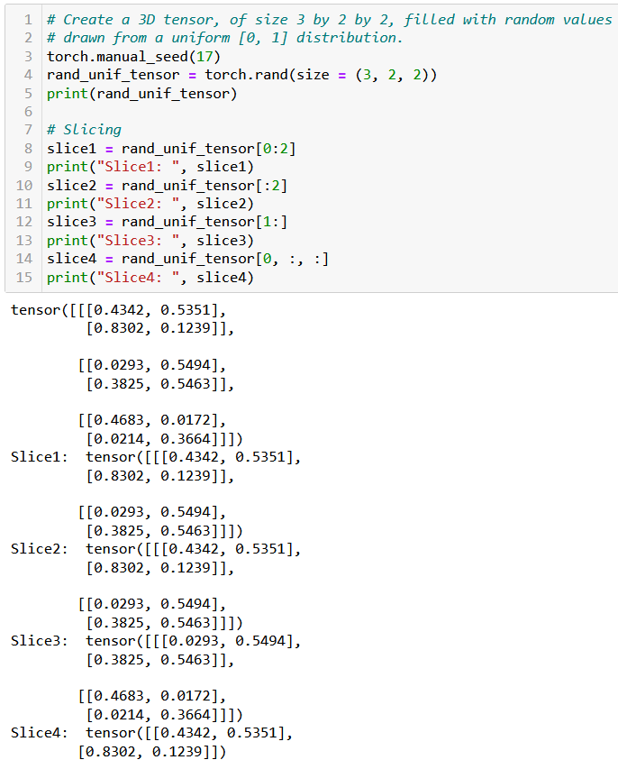
Basic operations on Tensors
All the typical element-wise operations work on tensors. For instance, we can:
access elements using the square bracket notation, multiple square bracket notations and multiple indexes in a single square bracket;
slice a tensor using the square bracket notation and colon symbol;
update elements of a tensor using the square bracket notation;
browse through elements of a tensor using a for loop.

Slide 21
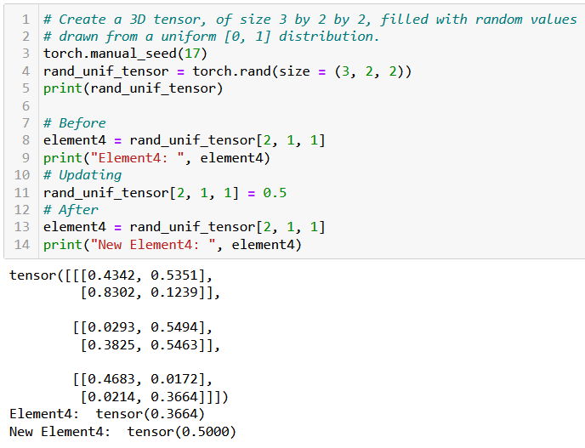
Basic operations on Tensors
All the typical element-wise operations work on tensors. For instance, we can:
access elements using the square bracket notation, multiple square bracket notations and multiple indexes in a single square bracket;
slice a tensor using the square bracket notation and colon symbol;
update elements of a tensor using the square bracket notation;
browse through elements of a tensor using a for loop.

Slide 22
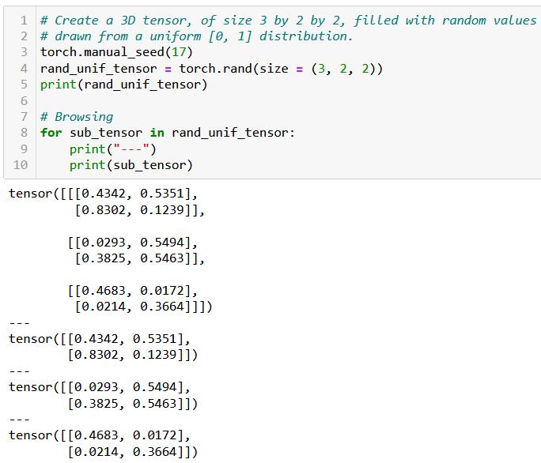
Basic operations on Tensors
All the typical element-wise operations work on tensors. For instance, we can:
access elements using the square bracket notation, multiple square bracket notations and multiple indexes in a single square bracket;
slice a tensor using the square bracket notation and colon symbol;
update elements of a tensor using the square bracket notation;
browse through elements of a tensor using a for loop.

Slide 23

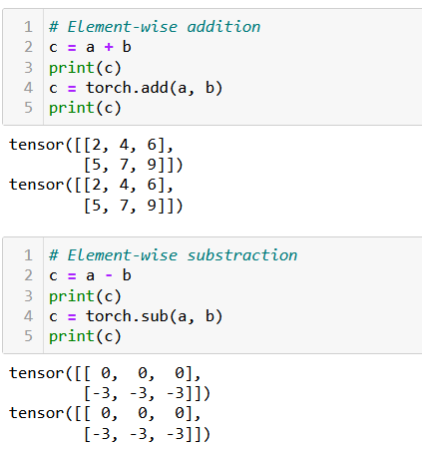
Arithmetic operations on Tensors
All NumPy array operations work on Tensors and equivalent methods have been written in torch as well.
Element-wise Addition/Subtraction,
Element-wise Multiplication/Division,
Transposition,
Matrix multiplication and dot product,
Etc.

Slide 24
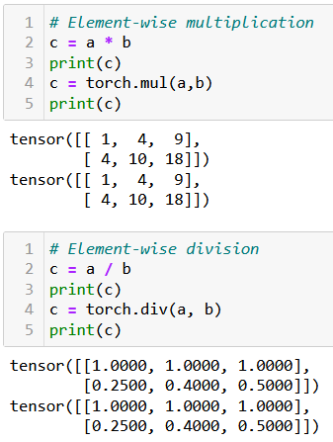
Arithmetic operations on Tensors
All NumPy array operations work on Tensors and equivalent methods have been written in torch as well.
Element-wise Addition/Subtraction,
Element-wise Multiplication/Division,
Transposition,
Matrix multiplication and dot product,
Etc.

Slide 25
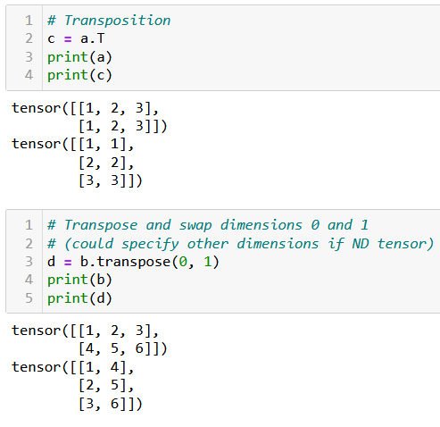
Arithmetic operations on Tensors
All NumPy array operations work on Tensors and equivalent methods have been written in torch as well.
Element-wise Addition/Subtraction,
Element-wise Multiplication/Division,
Transposition,
Matrix multiplication and dot product,
Etc.

Slide 26
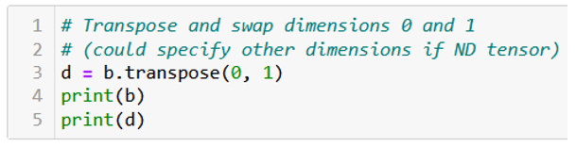
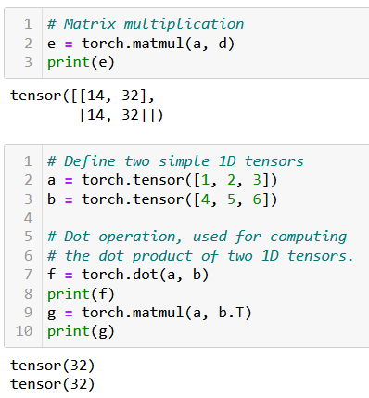
Arithmetic operations on Tensors
All NumPy array operations work on Tensors and equivalent methods have been written in torch as well.
Element-wise Addition/Subtraction,
Element-wise Multiplication/Division,
Transposition,
Matrix multiplication and dot product,
Etc.

Slide 27
A quick note on broadcasting
Tensors, just like NumPy arrays, support broadcasting.
Two tensors are “broadcastable” if the following rules hold:
Each tensor has at least one dimension.
When iterating over the dimension sizes, starting at the trailing dimension, the dimension sizes must either be equal, one of them is 1, or one of them does not exist.
If two tensors x, y are “broadcastable”, the resulting tensor size is calculated as follows:
If the number of dimensions of x and y are not equal, prepend 1 to the dimensions of the tensor with fewer dimensions to make them equal length.
Then, for each dimension size, the resulting dimension size is the max of the sizes of x and y along that dimension.

Slide 28
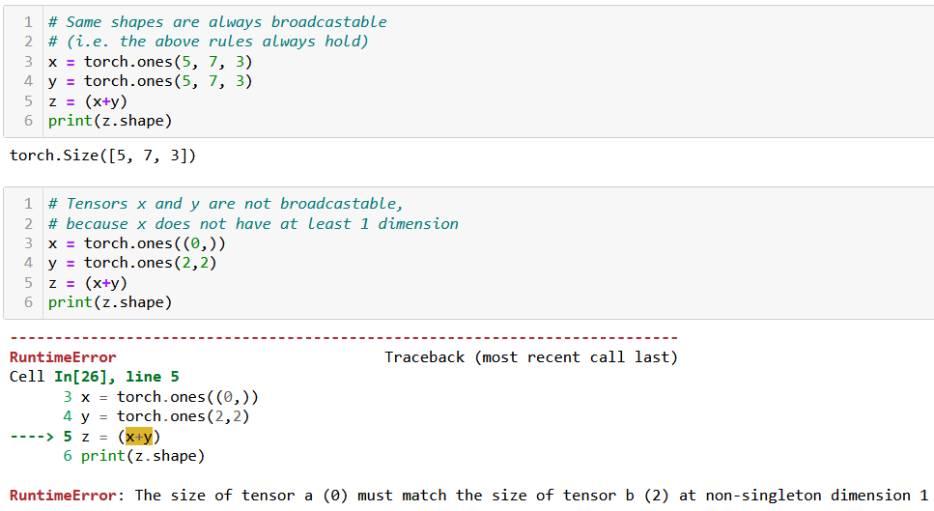
A quick note on broadcasting

Slide 29
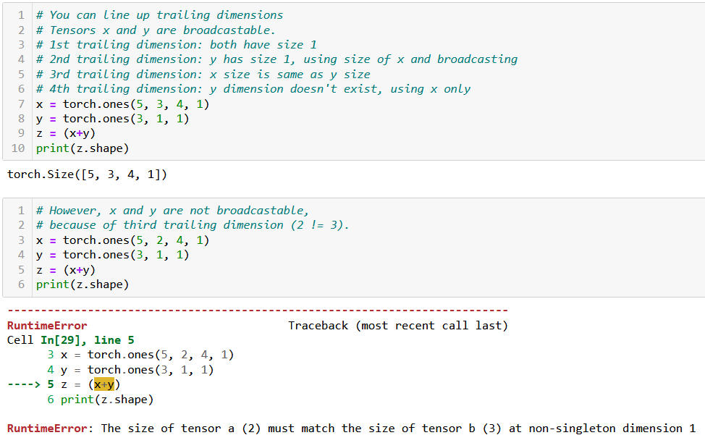
A quick note on broadcasting

Slide 30

Tensor locations
Recall: PyTorch has better support for GPU acceleration than NumPy.
If a GPU is available, significantly speed up the training of our neural network by performing the computations on the GPU using PyTorch.
Especially useful for training large and complex models.

Slide 31
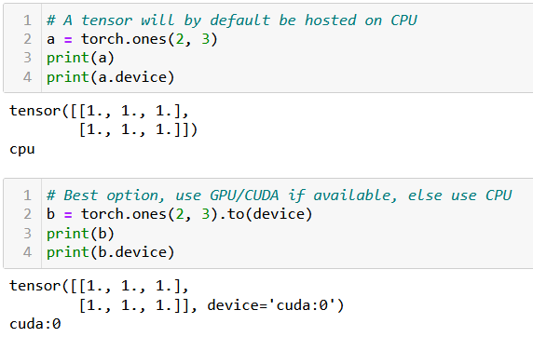
Tensor locations
By default, all tensors are used by the CPU. If device enabled for GPU/CUDA computation, transfer the tensor to the GPU for faster computation.
This is done in three ways:
Using .to(device) method will transfer to the best device available for computation (device variable defined earlier, when we checked for cuda/cpu).
Using .cpu() or .cuda() will force transfer to the cpu or cuda respectively. Note that it might fail if you machine is not CUDA compatible.

Slide 32
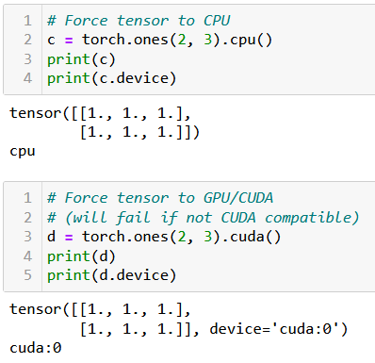
Tensor locations
By default, all tensors are used by the CPU. If device enabled for GPU/CUDA computation, transfer the tensor to the GPU for faster computation.
This is done in three ways:
Using .to(device) method will transfer to the best device available for computation (device variable defined earlier, when we checked for cuda/cpu).
Using .cpu() or .cuda() will force transfer to the cpu or cuda respectively. Note that it might fail if you machine is not CUDA compatible.

Slide 33
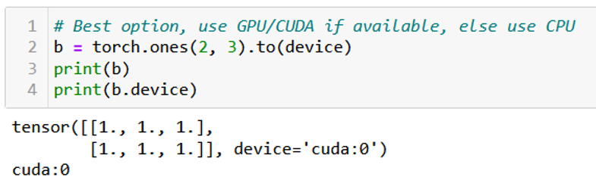
Tensor locations
By default, all tensors are used by the CPU. If device enabled for GPU/CUDA computation, transfer the tensor to the GPU for faster computation.
This is done in three ways:
Using .to(device) method will transfer to the best device available for computation (device variable defined earlier, when we checked for cuda/cpu).
Using .cpu() or .cuda() will force transfer to the cpu or cuda respectively. Note that it might fail if you machine is not CUDA compatible.
In doubt, you can check the device attribute of your tensors to find where their computations will occur.

Slide 34
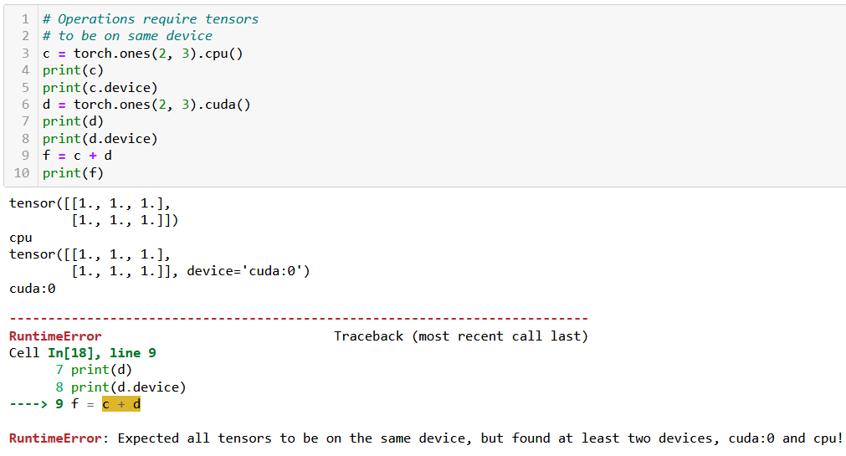
Tensor locations
Keep in mind: two tensors with different devices cannot be used in the same operation! (same logic as dtypes).

Slide 35
A bit of practice for you to try at home
In order to practice your PyTorch Tensor skills, you may try to manually implement your own version of typical algorithms we ran on lists/Numpy arrays in previous classes, using the basic operations on PyTorch tensors.
For instance, try writing algorithms:
Finding the maximum, minimum, average, median values of a given 1D tensor,
Transposing a given 2D tensor,
Sorting a given 1D tensor (bubble sort, insertion sort, selection sort, quick sort, merge sort),
Generating a 1D array containing the first K Fibonacci numbers with K given,
Etc.
Later, you can check their performance times compared to their numpy/pytorch implementations when running them on both CPU and CUDA (if available).
In which scenarios is it slower to implement said functions and run them on GPU?

Slide 36
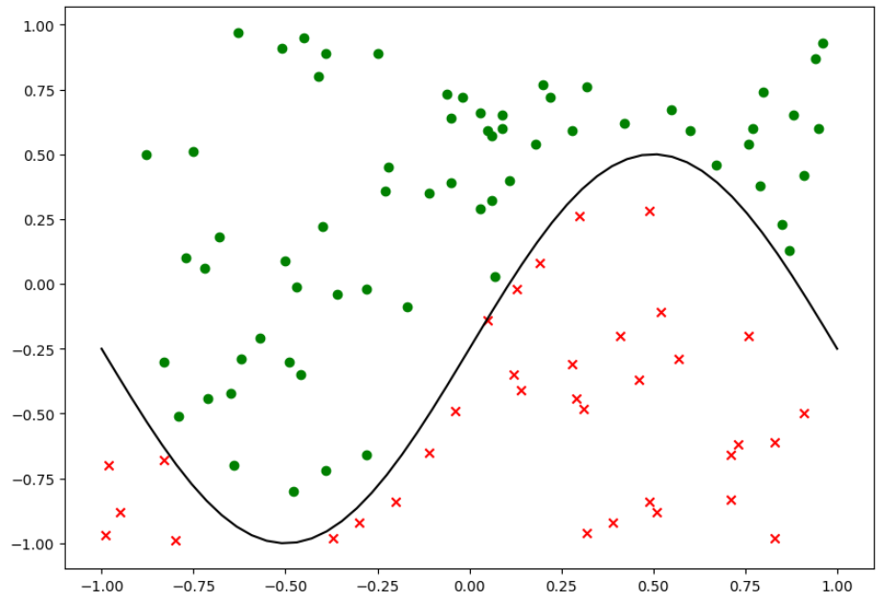
Same dataset as before

Slide 37
Our shallow neural network class
We will reuse our previous ShallowNeuralNet class from Week2 Notebook 7, which:
implements a Shallow neural network using two fully connected layers and sigmoid activation functions,
uses a Stochastic Mini-Batch gradient descent, with Adam as its optimizer,
uses a random normal initialization,
comes with a forward() method for predictions,
comes with a backward() and train() method for backpropagation training,
comes with a cross-entropy loss function and an accuracy calculating loss function,
comes with a display function, to show training curves on both the loss and the accuracy,
comes with save and load functions.
Let us start by replicating the init, forward, loss and accuracy methods in PyTorch.

Slide 38
Writing a PyTorch neural network
The main differences between the original class and the PyTorch version are:
The PyTorch version of the class should inherit from torch.nn.Module and call its parent's init method using super().
This is necessary because PyTorch uses classes inherited from torch.nn.Module to keep track of the layers and their parameters in a neural network.
Instead of using NumPy arrays for the weights and biases, the PyTorch version uses torch.nn.Parameter objects, which is a subclass of tensors, whose values can be trained and modified later.

Slide 39
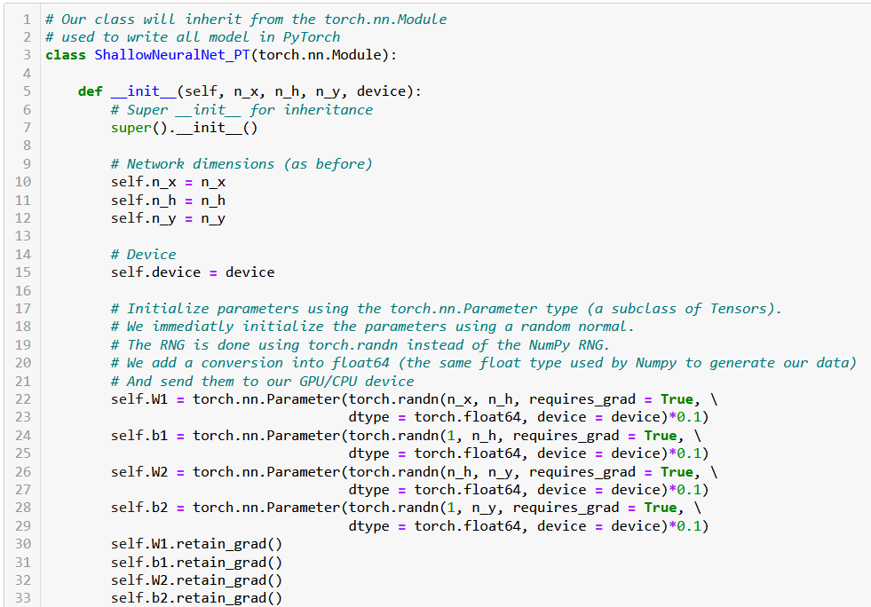

Slide 40
Writing a PyTorch neural network
In PyTorch, retain_grad is an attribute of tensors that allows the gradients to be accumulated for a particular tensor, during backpropagation.
Setting retain_grad to True for a tensor will tell PyTorch to keep track of operations happening during the forward pass, later allowing to compute the gradients of intermediate tensors.
This will eventually serve to perform parameters updates via backpropagation.
To keep it simple: Trainable parameters should allow for gradients to be retained for backpropagation.

Slide 41
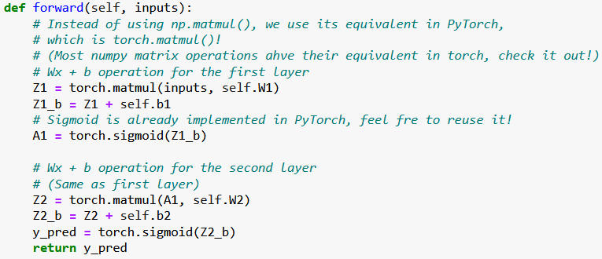
Rewriting the forward pass
The forward pass can be rewritten. You can replace the NumPy operations with their PyTorch equivalents. Similarly, our activation function sigmoid is replaced with PyTorch's torch.sigmoid function.

Slide 42
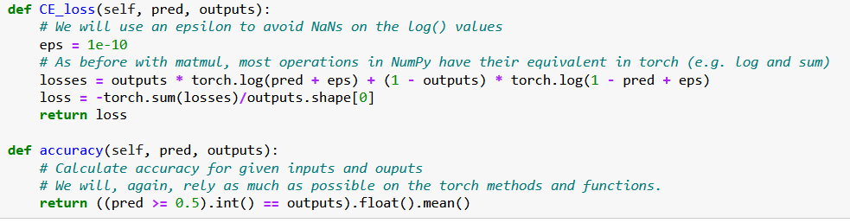
Rewriting the loss and accuracy functions
Similarly, we can rewrite the loss and accuracy functions using torch functions in place of the Numpy ones, also vectorizing operations as much as possible.

Slide 43
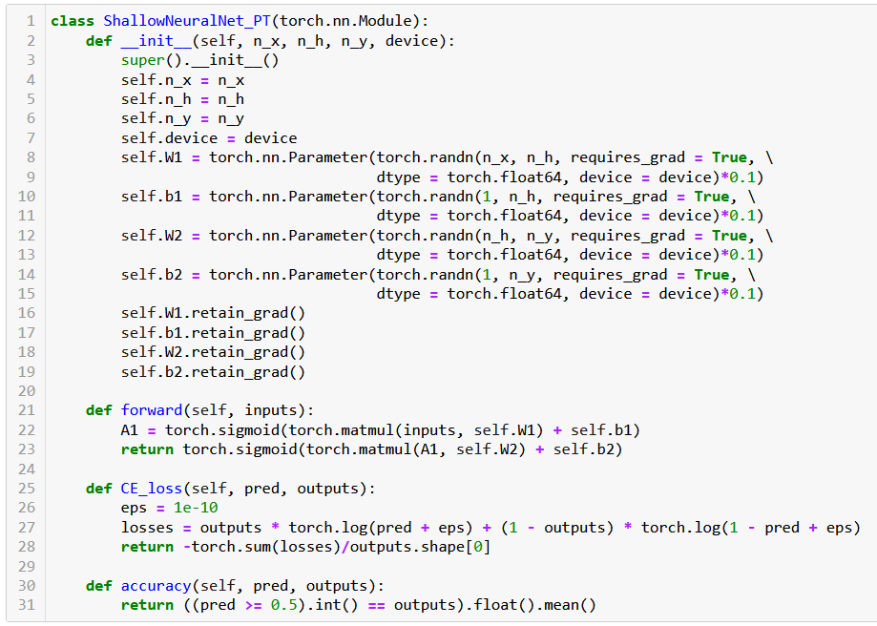

Slide 44
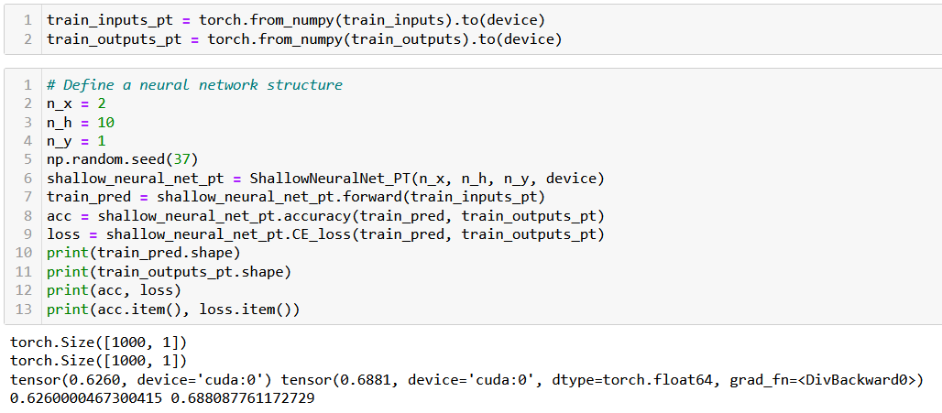
Trying out our new neural network
Before using this Neural Network on our dataset, we need to convert them to PyTorch Tensor objects and send them to GPU (if available).

Slide 45
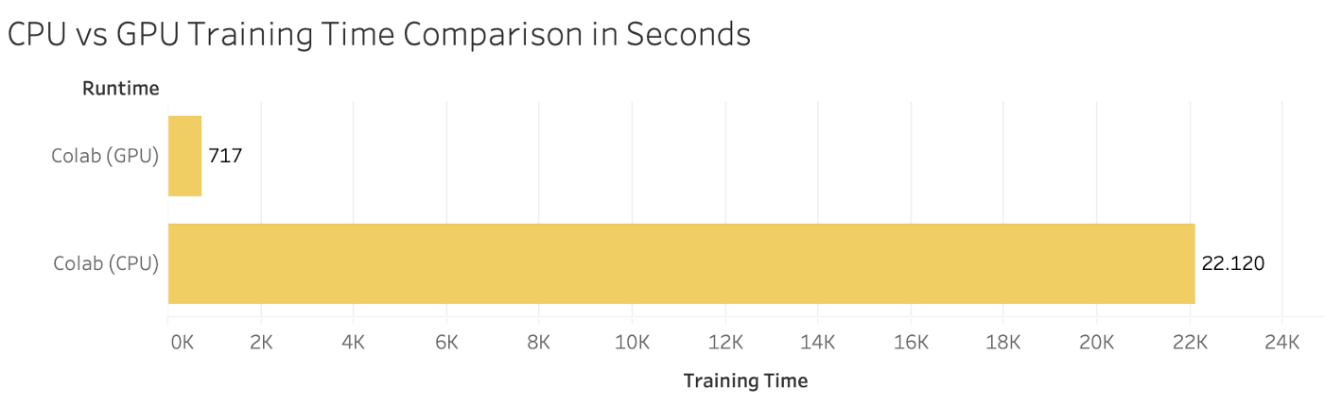
Computation times comparison
Let us run both models (the NumPy one and the PyTorch one) and ask them to perform 1000 times the accuracy computation.
On my machine (CUDA, Nvidia GTX 1060), the PyTorch model is roughly 30 times faster!
Obviously depends on your machine (could achieve even more).

Slide 46
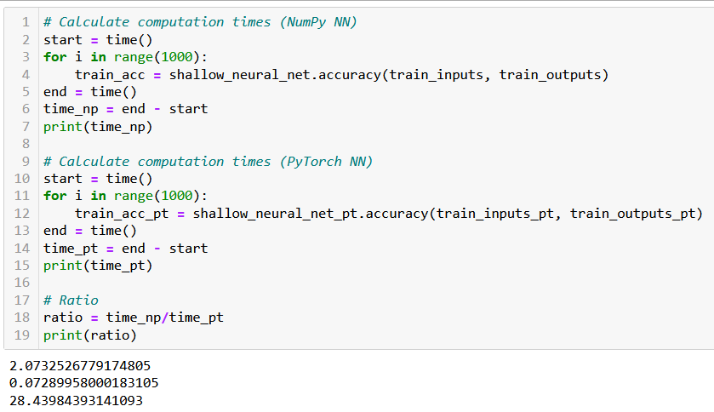
Computation times comparison

Slide 47
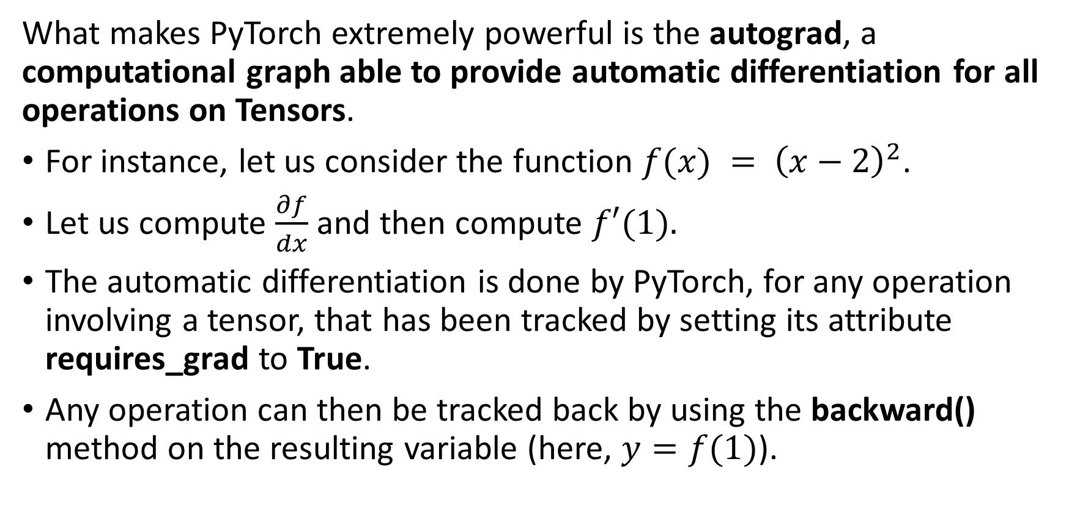
Autograd, the PyTorch beast
What makes PyTorch extremely powerful is the autograd, a computational graph able to provide automatic differentiation for all operations on Tensors.
For instance, let us consider the function $f(x) = {\left(x−2\right)}^{2}$.
Let us compute $\frac{∂f}{dx}$ and then compute $f′(1).$
The automatic differentiation is done by PyTorch, for any operation involving a tensor, that has been tracked by setting its attribute requires_grad to True.
Any operation can then be tracked back by using the backward() method on the resulting variable (here, $y=f(1)$).

Slide 48
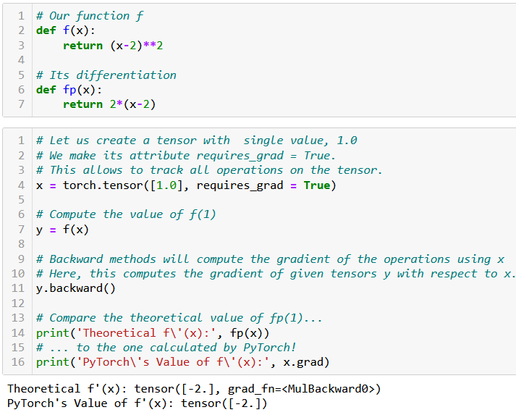
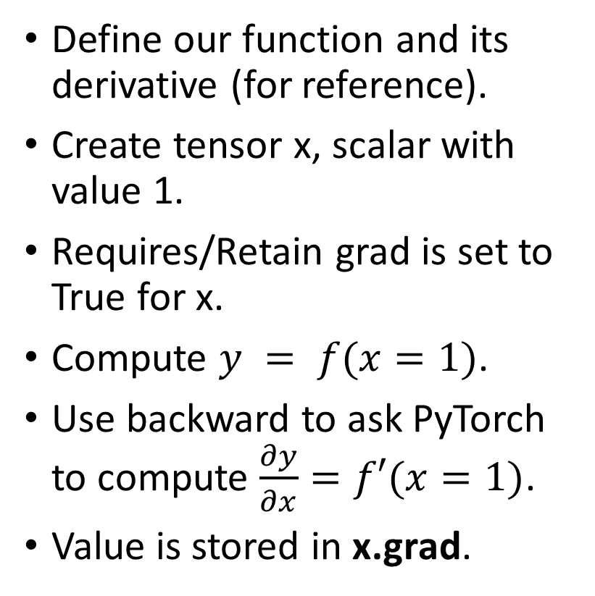
Autograd in action
Define our function and its derivative (for reference).
Create tensor x, scalar with value 1.
Requires/Retain grad is set to True for x.
Compute $y = f(x=1)$.
Use backward to ask PyTorch to compute $\frac{∂y}{∂x}=f′(x=1)$.
Value is stored in x.grad.

Slide 49
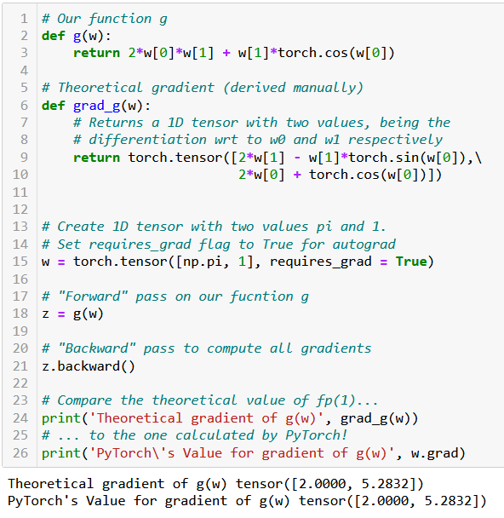
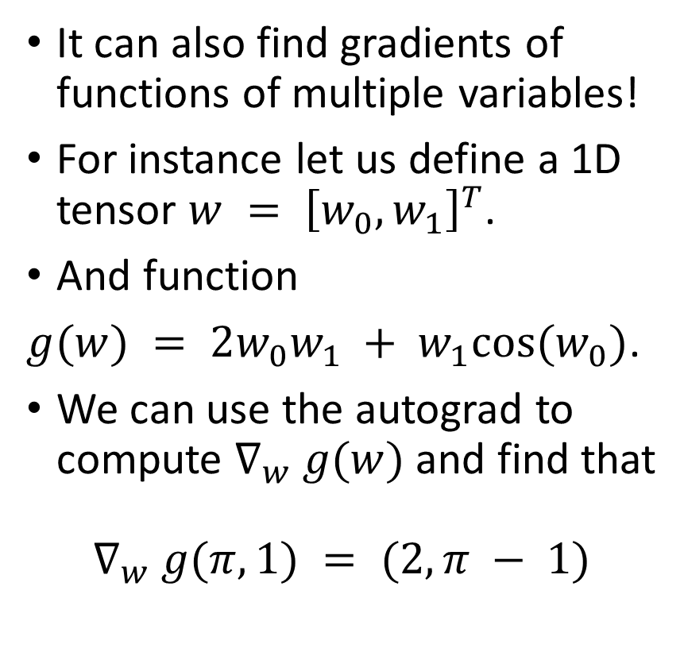
Autograd in action
It can also find gradients of functions of multiple variables!
For instance let us define a 1D tensor $w = {\left[w_{0}, w_{1}\right]}^{T}$.
And function
$g(w) = 2w_{0}w_{1} + w_{1}cos(w_{0})$.
We can use the autograd to compute $∇_{w} g(w)$and find that
$$∇_{w} g(π,1) = (2, π − 1)$$

Slide 50
Autograd, in short
The autograd is the key component of PyTorch, and why we like it so much.
This basically means that we do not need to calculate the gradients for any of our future gradient descent rules, manually again! (yay!)
The counterpart however is that all operation must involve tensors and must use PyTorch functions and methods... (but that is ok).
You do not need to know how it implements the computation of all gradients in the background, but if you are curious, have a look at this: https://pytorch.org/blog/computational-graphs-constructed-in-pytorch/.

Slide 51
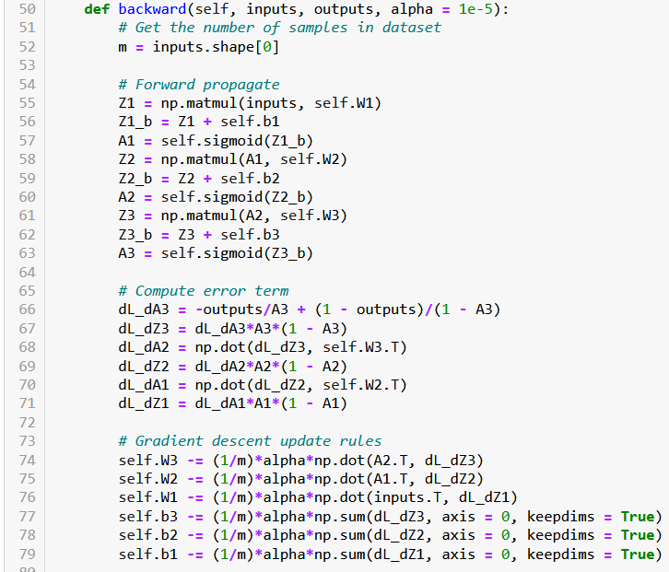
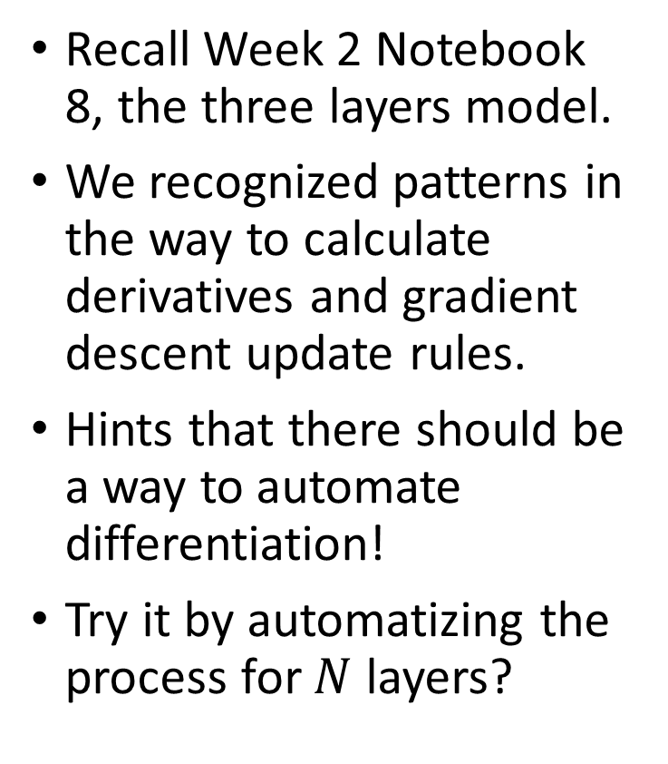
Autograd intuition
Recall Week 2 Notebook 8, the three layers model.
We recognized patterns in the way to calculate derivatives and gradient descent update rules.
Hints that there should be a way to automate differentiation!
Try it by automatizing the process for $N$ layers?

Slide 52
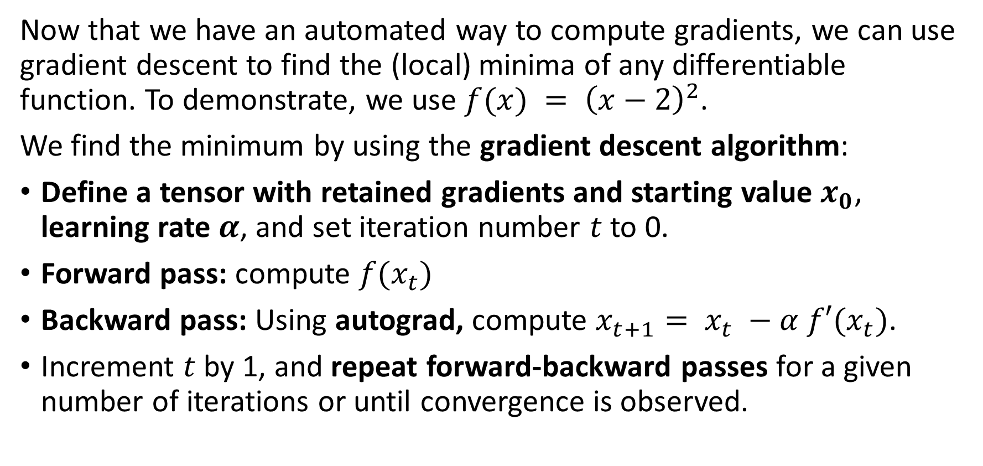
Implementing gradient descent with autograd
Now that we have an automated way to compute gradients, we can use gradient descent to find the (local) minima of any differentiable function. To demonstrate, we use $f(x) = {\left(x−2\right)}^{2}$.
We find the minimum by using the gradient descent algorithm:
Define a tensor with retained gradients and starting value $x_{0}$, learning rate $α$, and set iteration number $t$ to 0.
Forward pass: compute $f(x_{t})$
Backward pass: Using autograd, compute $x_{t+1}= x_{t} −α f′(x_{t})$.
Increment $t$ by 1, and repeat forward-backward passes for a given number of iterations or until convergence is observed.

Slide 53
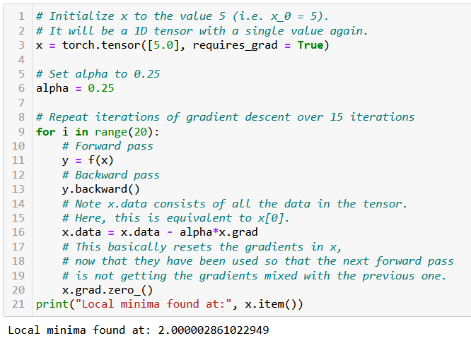
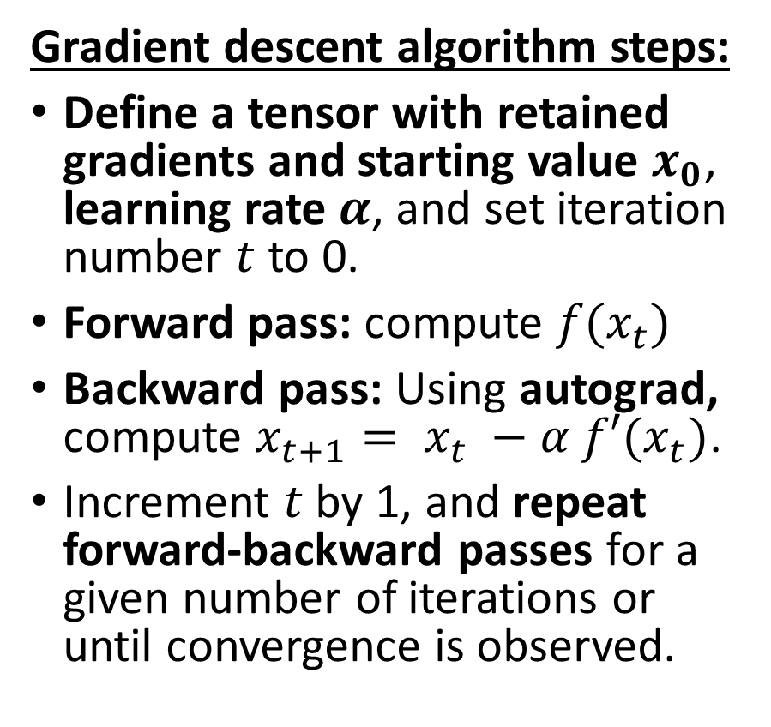
Implementing gradient descent with autograd
Gradient descent algorithm steps:
Define a tensor with retained gradients and starting value $x_{0}$, learning rate $α$, and set iteration number $t$ to 0.
Forward pass: compute $f(x_{t})$
Backward pass: Using autograd, compute $x_{t+1}= x_{t} −α f′(x_{t})$.
Increment $t$ by 1, and repeat forward-backward passes for a given number of iterations or until convergence is observed.

Slide 54
Rewriting our backpropagation
In order to train our Neural Network, we will rely on the power of the autograd to compute the gradient update for us automatically.
For this reason,
There is no need for a backward() method as before to compute gradients and gradient descent update rules (covered automatically by PyTorch autograd, yay!).
Our train() method will consist of several iterations of
forward() pass and loss calculation,
gradient computation with backward(), used on loss,
and gradient descent updates on trainable parameters.

Slide 55
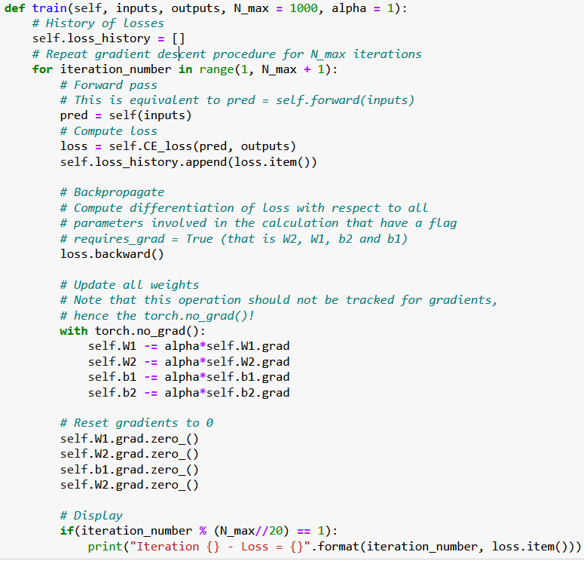
Backpropagation
Our train() method will be rewritten and now consists of several iterations of
forward() pass and loss calculation,
gradient computation with backward(), used on loss,
and gradient descent updates on trainable parameters.

Slide 56
Backpropagation
Important note:
Using with torch.no_grad(): tells PyTorch that the operations should not be tracked by the autograd.
Indeed, when performing gradient update for a trainable parameter, we do not want to update gradients for other trainable parameters!

Slide 57
Backpropagation
Important note #2:
Also, do not forget to reset your gradients to zero before the next iteration!
Otherwise, they will accumulate (and we do not want that!)
This can be simply done with grad.zero_().

Slide 58
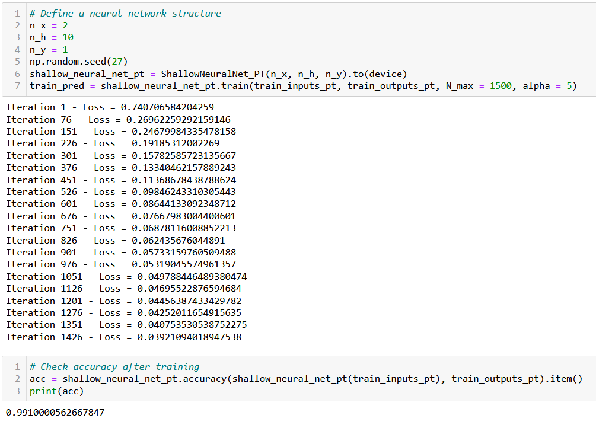
Trying our trainer function

Slide 59
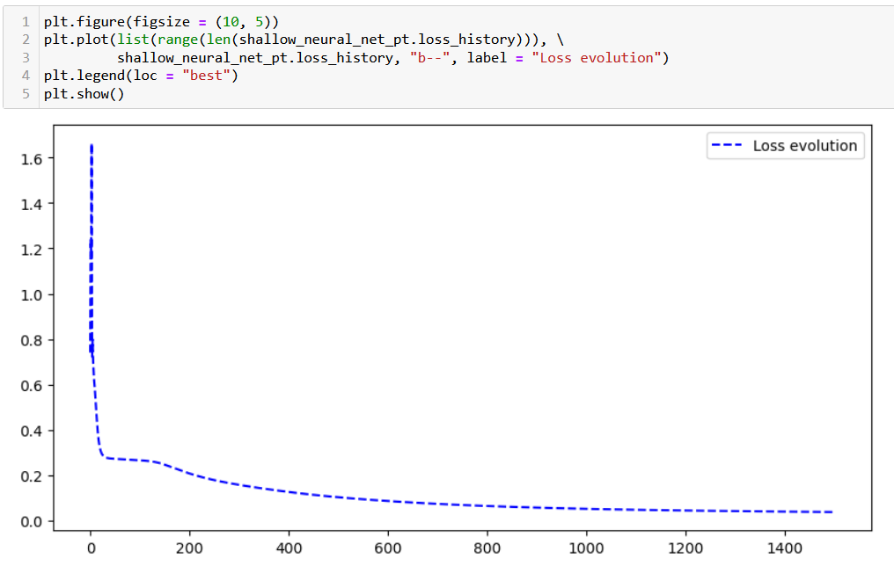
Trying our trainer function

Slide 60
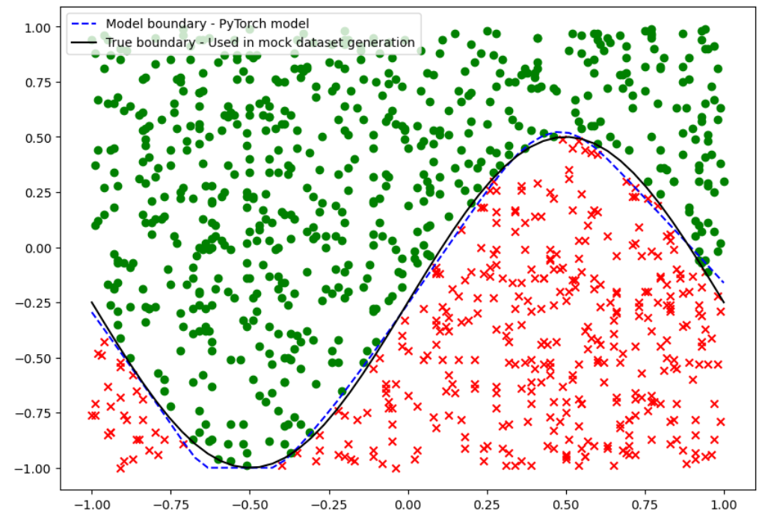
Trying our trainer function

Slide 61
Using PyTorch losses and metrics
In order to make our model even simpler and more efficient, we will use the loss functions and evaluation functions from PyTorch.
Our CE_loss() and accuracy() methods will therefore be replaced with the nn.BCELoss() function and the BinaryAccuracy() functions from the PyTorch and PyTorchMetrics libraries.
Feel free to have a look at the loss functions available in PyTorch, here: https://pytorch.org/docs/stable/nn.html#loss-functions.
Torchmetrics also provides a few additional losses and metrics functions, ready to use with PyTorch: https://torchmetrics.readthedocs.io/en/stable/all-metrics.html.

Slide 62


Slide 63


Slide 64


Slide 65
Using advanced optimizers (Adam, etc.)
Our next step is logically to replace our vanilla gradient descent with some more advanced optimizers, e.g. Adam, AdaGrad, RMSProp, etc.
Again, we will be relying on PyTorch as much as possible.
Feel free to have a look at all the available optimizers, here: https://pytorch.org/docs/stable/optim.html
Let us discuss how to use them in our Neural Network!

Slide 66
Using advanced optimizers (Adam, etc.)
Three modifications are to be considered to use Adam instead of the Vanilla gradient descent rule.
Adam will be added as an optimizer and its parameters can be passed to the train() method. It will simply consist of an additional variable.
optimizer = torch.optim.Adam(self.parameters(), lr = alpha, betas = (beta1, beta2), eps = 1e-08)
The optimizer.step() is used to update the V and S parameters in Adam. This also replaces the gradient rule update entirely (damn!).
You should remember to reset gradients in optimizer to 0, like you would in the parameters tensors. The operation optimizer.zero_grad() replaces all four self.Xx.grad.zero_() operations we had earlier!

Slide 67


Slide 68
Using advanced optimizers (Adam, etc.)
Feel free to also have a look at the implementation of these optimizers. You should recognize our concepts from Week 2! These optimizers come with a few more features that might be worth exploring!
https://pytorch.org/docs/stable/generated/torch.optim.Adam.html#torch.optim.Adam
Note: implementing your own optimizer is generally a bad idea, but feel free to have a look at the code to see what it takes!
https://pytorch.org/docs/stable/_modules/torch/optim/adam.html#Adam

Slide 69
Implementing a stochastic mini-batch GD
We can also define a Stochastic Mini-Batches Gradient Descent procedure. This is typically done with two steps.
Create a Dataset and a Dataloader using the inputs and outputs provided in the train().
(We will learn more about these Dataset and Dataloader objects in the next notebook and lecture. For now, just consider that it allows to conveniently zip the data in an object that is able to shuffle and draw randomly mini-batches of data for us.)
2. Loop over the mini-batches of data, instead of using the entire inputs/outputs at once, like in (full) batch gradient descent.

Slide 70


Slide 71


Slide 72

Better initializers in PyTorch
This part is a bit tedious and relies on our own manual implementation of a random normal initializer.
Need for PyTorch initializers!

Slide 73

Better initializers in PyTorch
Fixed!
Feel free to have a look at this for additional initializers in PyTorch. https://pytorch.org/cppdocs/api/file_torch_csrc_api_include_torch_nn_init.h.html#file-torch-csrc-api-include-torch-nn-init-h

Slide 74


Adding a L1 regularization to our loss
We have also seen during Ridge Regression that we can add a regularization term to our loss function.
Our first step would be to simply compute our regularization term by using the PyTorch functions, for instance the L1 loss.
We would then simply add it to the loss before backpropagating.

Slide 75
To summarize
We now have a full Neural Network class, in PyTorch, with:
2 linear layers, sigmoid activation functions,
Xavier uniform initialization on trainable parameters,
Forward pass method,
Autograd backpropagation and trainer method,
Adam optimizer,
Dataloader allowing for stochastic mini-batches,
Cross entropy loss and accuracies,
L1 regularization.
And it runs/trains at the speed of light (almost…) on GPU!

Slide 76


Slide 80
Dataset, softmax on predictions

Slide 85
Conclusion (Week 3)
XXX
XXX

Slide 86
Learn more about these topics
Out of class, supporting papers, for those of you who are curious.
[XXX] XXX

Slide 87
Learn more about these topics
Some extra (easy) reading and videos for those of you who are curious.
[XXX] XXX

